Slide 1


Slide 2
Regression Models

Slide 3
Regression
We talk about regression when the outcome is a continuous variable, instead of a class.
Many classification problems can be solved as regression problems, by using a threshold on the continuous variable.
For example, how could you solve the planet habitability problem as regression?
Which approach is preferable?

Slide 4
Main difference: evaluation
The classification metrics (accuracy, precision, recall…) we have used so far won’t work – why?
We need something that measures how close we are to the correct answer. Ideas?
I will show some examples, but in my experience: easier said than done!

Slide 5
Correlation
Often, we use some kind of correlation analysis to measure the strength of the association between input and output.
Only concerned with strength of the relationship
No causal effect is implied
Problem: the strength of the correlation is difficult to quantify!

Slide 6
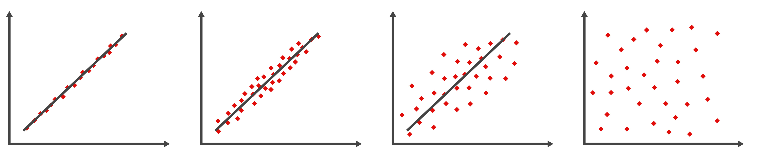
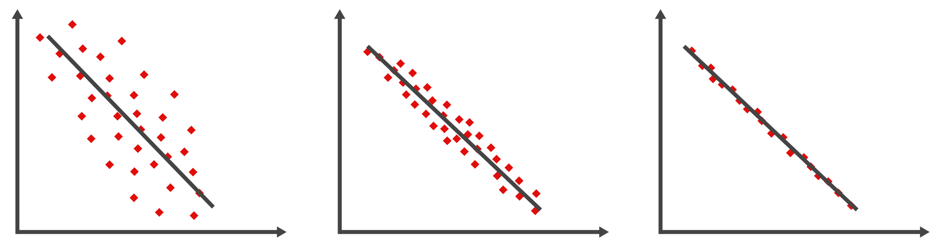
Examples
Notes:
Figures licensed from Adobe Stock.

Slide 7
Regression metrics
How “strong” is relationship between predictors & outcome?
We can attempt to measure the fraction of observed variance of the target variable (“outcome”) that can be explained by the features (”predictors”):
where y_{i} = true values,
the bar denotes the mean, and the hat denotes the prediction.
SST = Sum of Total Squares
SSR = Sum of Squares due to Residuals

Slide 8
Coefficient of Determination R²
How “strong” is relationship between predictors & outcome?
where:
SSR = sum of squares due to residuals
SST = total sum of squares
R² =
1 - SSR/SST
Statistics books will normally tell you that R² is bounded between 0 and 1.
1 indicates perfect correlation, and 0 indicates no relationship
(a model that predicts the mean of true values will have R² = 0).
In machine learning, however,
we build the model using only on the training set.
So R² can be negative on the test set
(e.g., the predictions can be arbitrarily bad, worse than the mean!)

Slide 9
INterpreting the Coefficient of Determination
If R² has a value of 0.6, this means 60% of the variation in the dependent variable (y) is explained by your regression model. The remaining 40% is unexplained.
Unlike the indicators used for classification problems, the coefficient of determination does not have a critical value that enables us to draw conclusions.
The higher the value of R², the better the model fits the data.
R² = 1: Perfect match between the line and the data points.
Interpreting R² = 0.9 is much more complicated. In particular, it does not mean that “predictions are within 10% of the correct value”.

Slide 10
IS R² useless?
Many influential statisticians think so - see famously:
http://www.stat.cmu.edu/~cshalizi/ADAfaEPoV/
One issue is that adding (linearly independent) features always results in better (train) R² – no penalty for overfitting.
Another issue is that – like all measures of correlation – applying a nonlinear coordinate transformation will change R².
My view: When it is used in a machine learning setting (i.e. we look at R² for predictions, on test set), it is a useful tool to compare models.
If features and targets are the same, a model with higher R² score on the predicted values is better.
Note that we can’t distinguish between a poor R² that comes from bad modeling, and a poor R² that comes from noisy data :(

Slide 11
Do we have other metrics?
Many others, of course!
For example, the mean square error, the mean (median) absolute error, the root mean square error.
yes, it’s just the square root
of the MSE; but it is useful
because it gives *typical* deviation
For an unbiased predictive model (mean of residuals vector = 0),
the MSE/RMSE are just the variance/standard deviation of the residuals.

Slide 12
Which one should i use?
I really don’t know.
In many cases, as we have seen, the optimized metric (the loss function that is minimized) is hard-coded into algorithms, so picking a metric is mostly relevant for model comparison (parameter optimization or comparison of different algorithms).
In science, my experience is that MSE/RMSE are often the ones that are easier to interpret.
We can also look at multiple metrics/indicators.
My take-home message is that evaluating regression models is highly non-trivial.

Slide 13
Linear regression
In which we hypothesize that the relationship between independent variable(s), i.e. features, and the outcome, i.e. the target variable, is LINEAR.
Is it machine learning? Is it modeling?
(Is this the real life? Is it just fantasy?)
To create a linear model with a probabilistic interpretation (i.e., a likelihood), which allows us to do inference on the parameters, we need several assumptions to hold. In ML, we can be less rigorous.

Slide 14
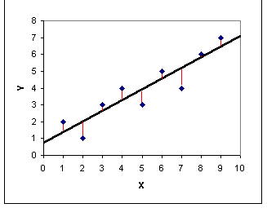
Ordinary least squares
The Least Squares Regression Line is the line that minimizes the sum of the squares of the error
(y – y_{pred})²
Which loss function are we minimizing when we do the OLS fit?
The Mean Square Error
We can re-interpret our fitting procedure in ML “language” as minimizing the MSE loss.

Slide 15
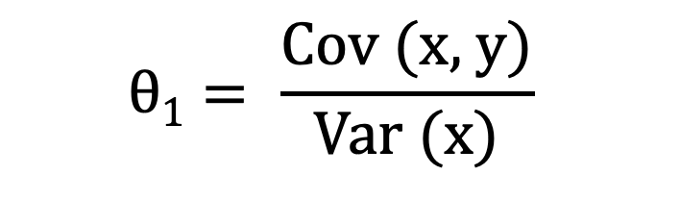

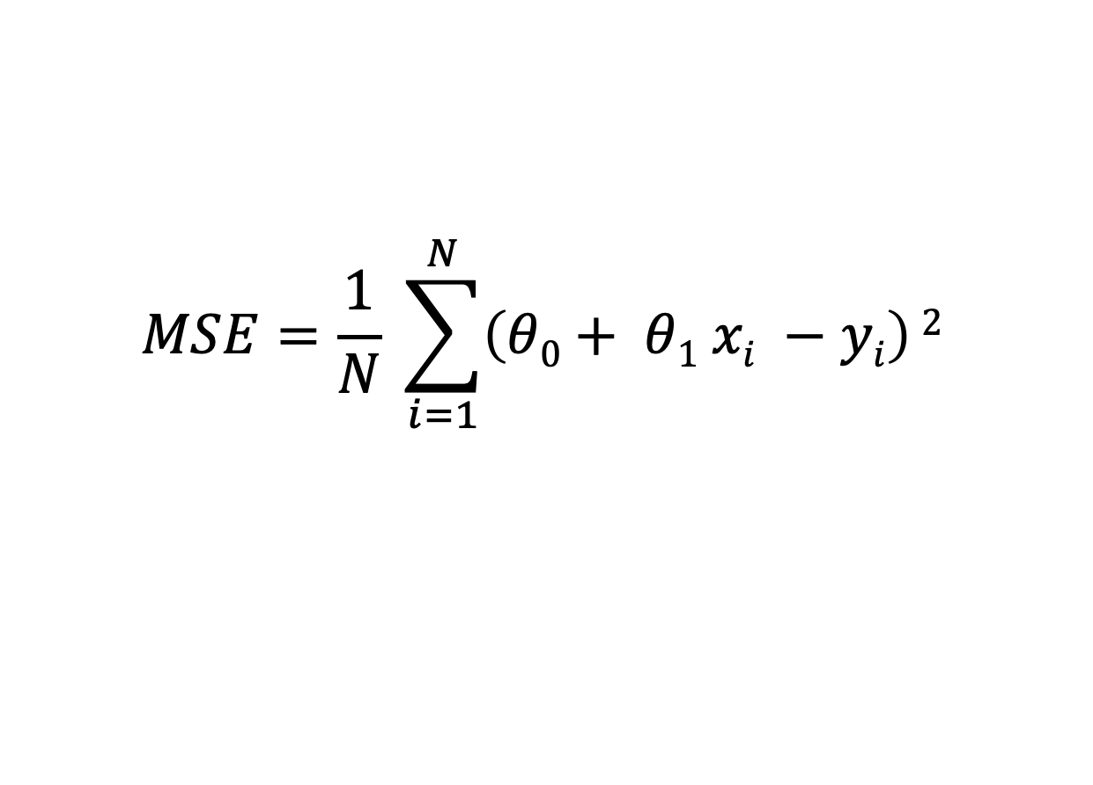
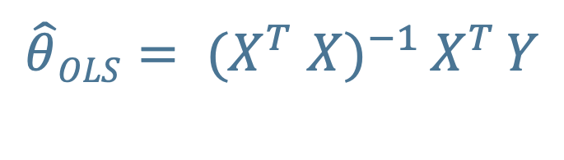
OLS – analytic solution
If we write the MSE for the simple one-dimensional case (fitting a line), we get
$$MSE=\frac{1}{N} \sum_{i=1}^{N}{\left(θ0+ θ1 xi −yi\right)}2$$
Any idea of how to get an analytic solution?
$$θ1= \frac{\text{Cov}\text{ (}\text{x}\text{, }\text{y}\text{)}}{\text{Var}\text{ (}\text{x}\text{)}}$$
$$θ0=\overline{y} − θ1 \overline{x}$$
For the n-dimensional case, the solution is the normal equation:
$\hat{θ}OLS= {(X}^{T}$ ${X)}^{−1 }X^{T }Y$
X = features matrix, Y = obs vector (for train set)
Derivation

Slide 16
Changing metric
What happens if I want to minimize, say, the MAE (Mean Absolute Error)?
1. Will the fit change?
2. Analytic solution?
3. Any idea about implementation?

Slide 17
GRADIENT DESCENT
(smart minimization of loss functions)
The normal equation provides an analytic solution
for the MSE loss only.
Additionally, it requires inverting the matrix
X^{T} · X (what’s its size)?
which is slow when the number of features, m, is large
(typically scales as O(m³) or a little better).
To optimize a different loss function, or speed things up,
it’s useful to have numerical optimization methods in place.
The most popular one is called Gradient Descent.

Slide 18

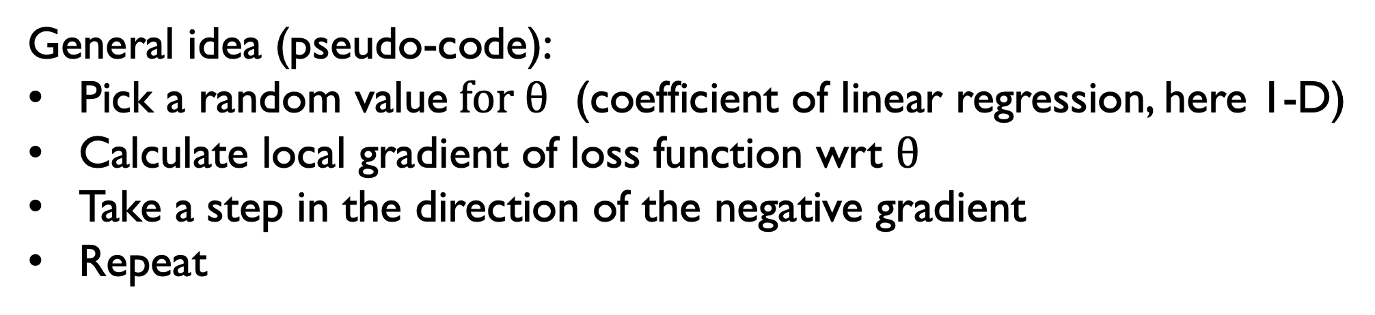
Batch gradient descent
initial value
GD path
argmin(loss)
$$θ$$
General idea (pseudo-code):
Pick a random value$for θ$ (coefficient of linear regression, here 1-D)
Calculate local gradient of loss function wrt $θ$
Take a step in the direction of the negative gradient
Repeat
Questions: will it converge? Under which conditions?

Slide 19


Batch gradient descent
For the MSE loss,
we don’t need to worry about non-convexity,
but choosing a good ”step size” is very important.
steps are too small
steps are too large
$$θ$$
$$θ$$
Other loss functions might not be convex,
and this method might need refinement.

Slide 20
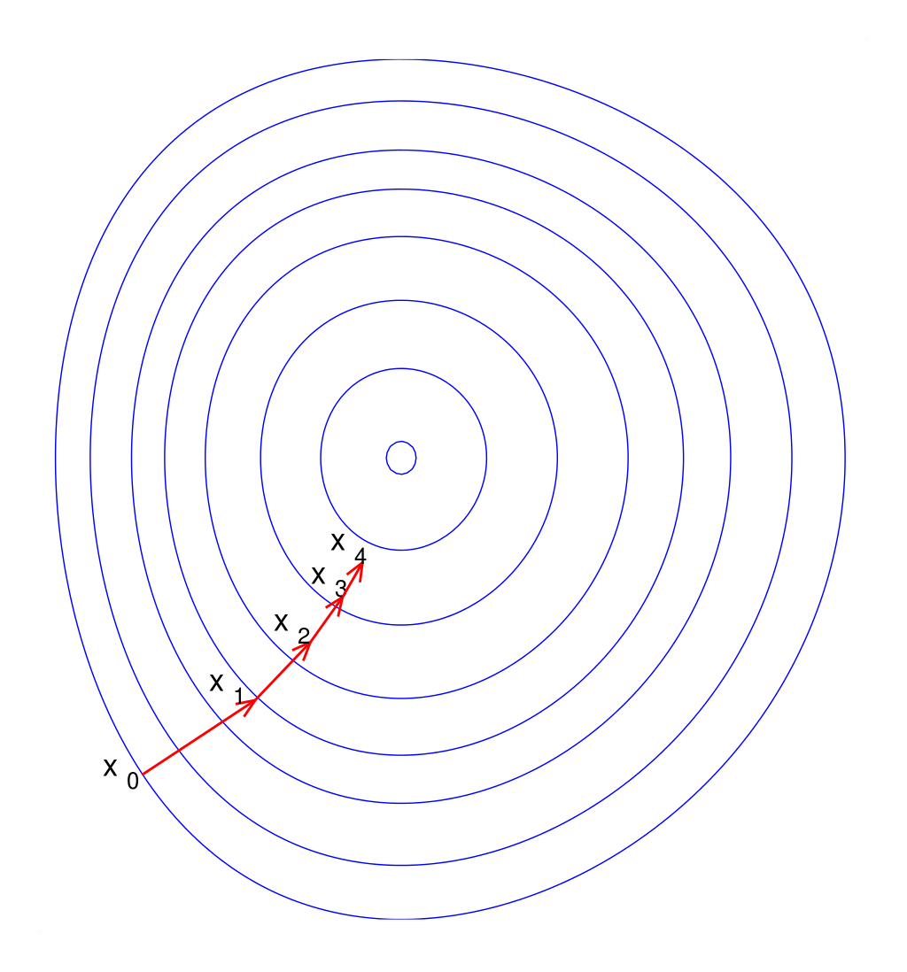
How about scaling? Does it matter?
Yes (for efficiency)!
We need either a feature-dependent learning rate, or (more easily) to scale the feature matrix.
Notes:
This image is from Wikipedia and has a Public Domain license.

Slide 21
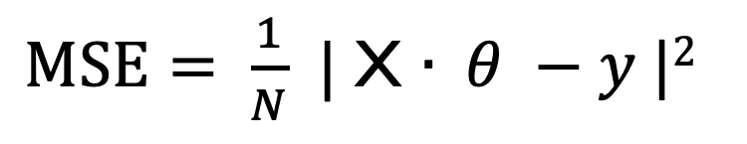
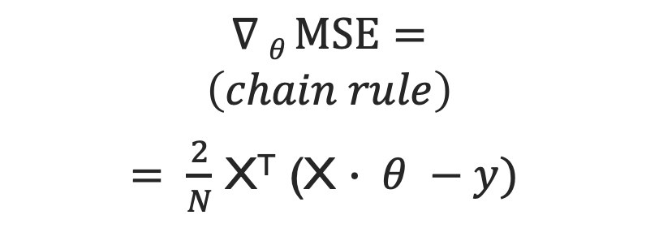
Implementation (MSE loss)
$MSE= \frac{1}{N}$ | X $∙ θ −y |2$
$$∇ θ MSE=$$
$$\left(chain rule\right)$$
$= \frac{2}{N}$ X^{T} (X $∙ θ −y)$
Note that we add a bias term, a "fake" feature = 1, to every instance. This is so we can express the linear model in matrix multiplication form.
Advantages of GD over normal equation for linear model:
No matrix inversion needed
Complexity scaling is now linear with m (# of features),
although it’s not great with N (# of samples) because we calculate
the gradients by summing over the entire learning set

Slide 22
Improvements on “regular” (batch) GD
Stochastic Gradient Descent (compute gradient on only one random example)
Mini-Batch Gradient Descent (compute gradient on a few random examples)
Learning schedule: change learning rate as you get closer to minimum

Slide 23
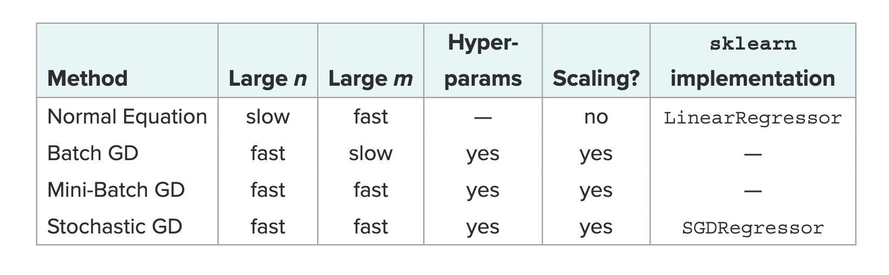
Summary linear regression solvers, MSE LOSS
Note however that the GD methods can all be used for other loss functions;
The only difference is that the gradient computation is not analytical.
Table adapted from Geron, 2019

Slide 24
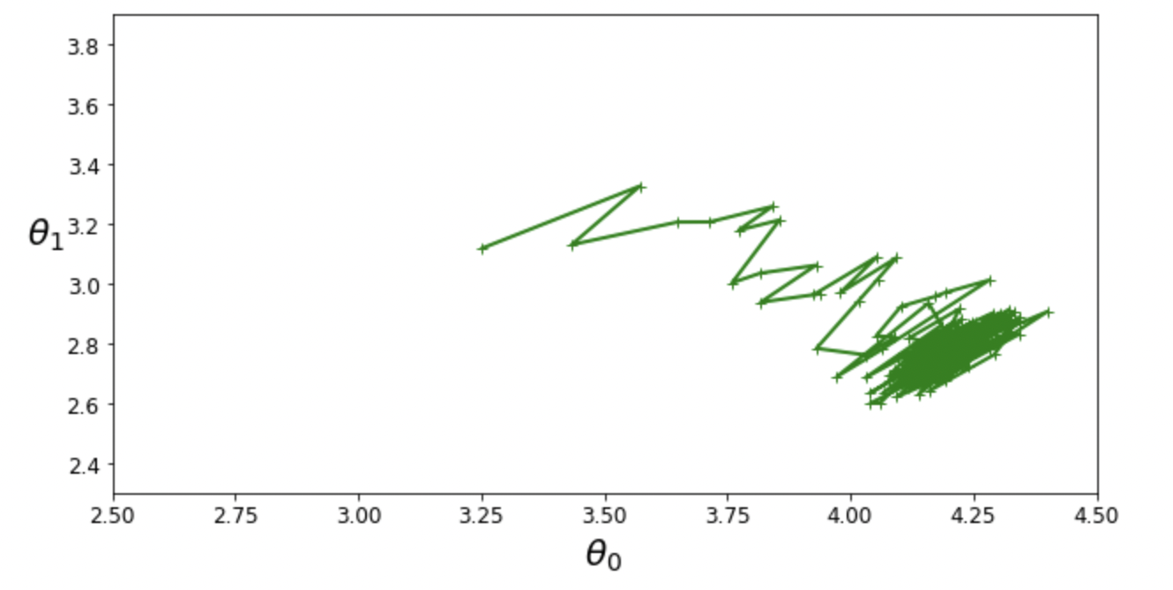
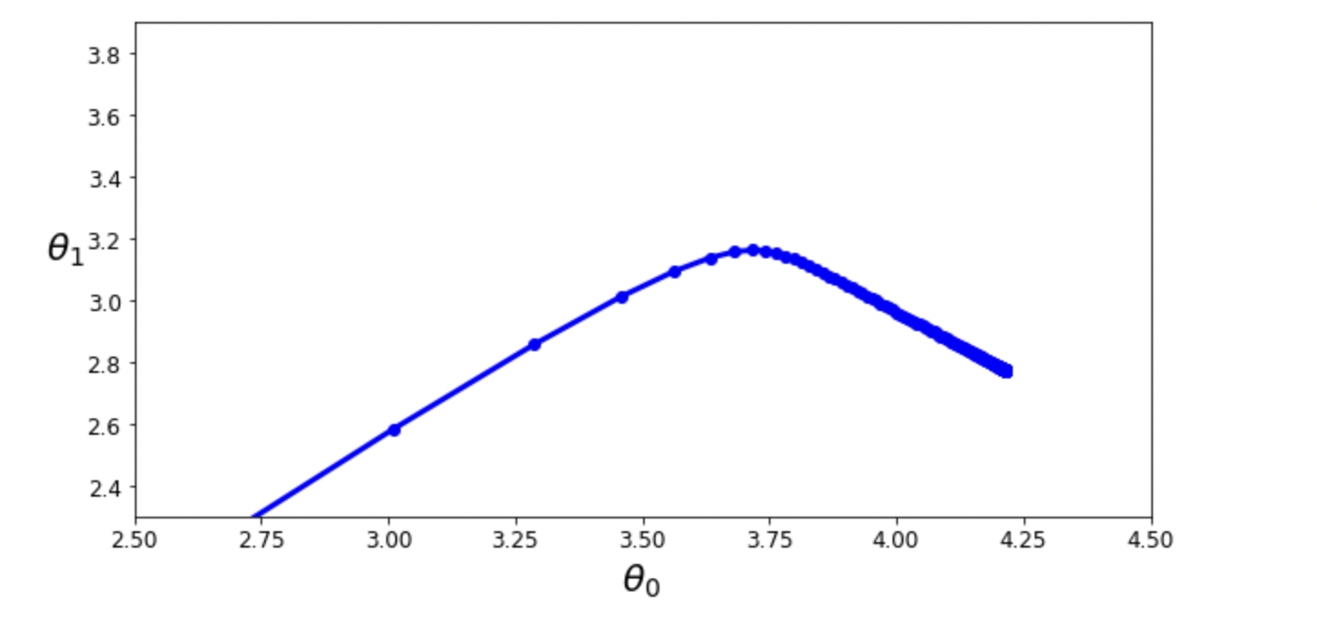
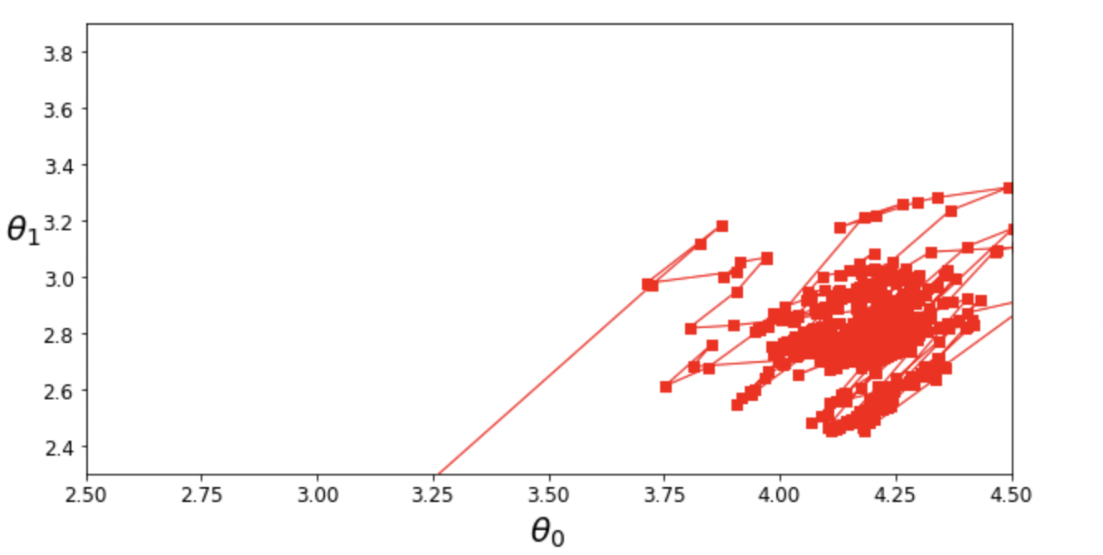
a) Batch GD
b) SGD
c) Mini Batch GD

